Slide 1

Ubuntu 20.04 Secure Server Hardening
Final Report – July 2025 Ramjith M

Slide 2
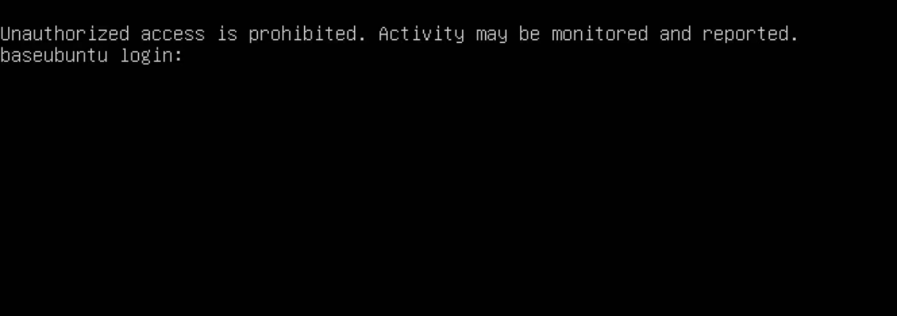
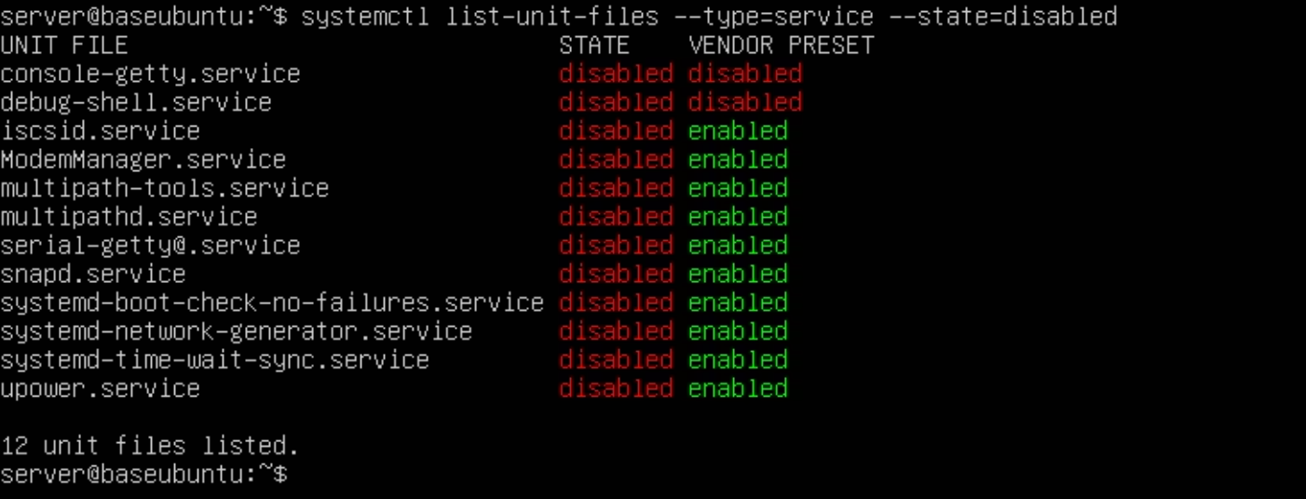



Login Page
disabled services
Executive Summary
Purpose
Tools Utilised
Outcome
Harden a Linux server using CIS benchmarks for robust security posture.
Nmap, OpenVAS, Lynis, auditd, UFW, PAM, rkhunter, chkrootkit for comprehensive assessment.
Achieved Lynis score of 73, zero high/medium vulnerabilities, and hardened SSH/services.

Slide 3
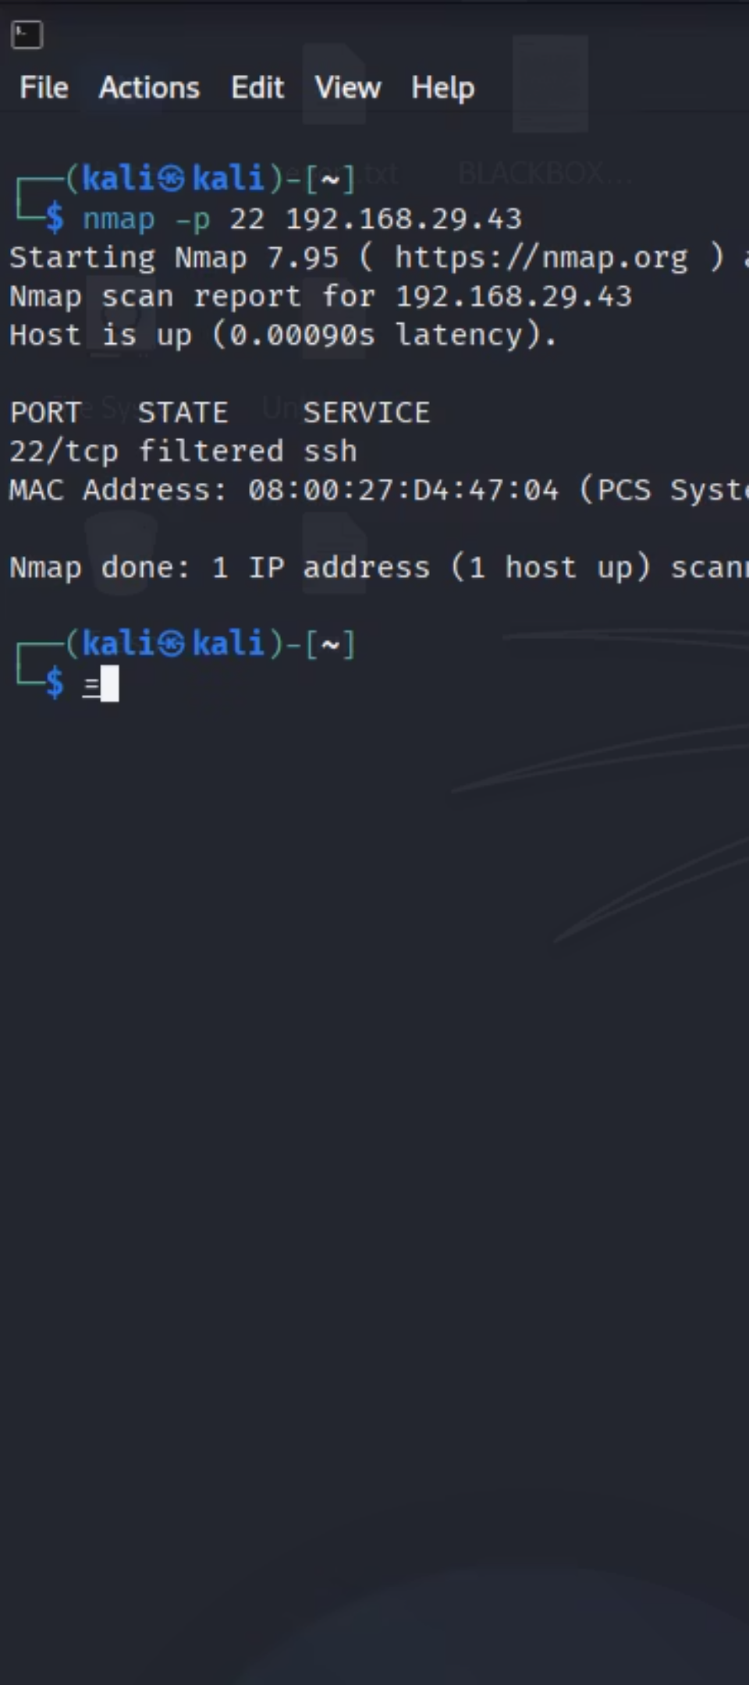
Before vs. After Comparison
1
Initial Nmap Scan
2
Hardened Nmap Scan
Port 22 open (SSH exposed)
Port 22 filtered (SSH secured)
1
Initial Lynis Score
2
Final Lynis Score
Approx. 50 (suboptimal)
73 (improved security)
1
Initial OpenVAS Scan
2
Final OpenVAS Scan
24 informational/debug vulnerabilities
Zero real vulnerabilities detected

Slide 4






System Configuration Summary
SSH Hardening
PAM Policies
Audit Logging
Disabled root login, enforced key-based authentication, limited user access.
Mandatory strong password complexity and expiry enforced for all users.
Comprehensive system activity logging enabled via auditd for forensic analysis.
Automatic Updates
File & Service Lockdowns
Hardened Linux server using CIS benchmarks for robust security posture.
Configured unattended-upgrades for timely security patch application.
Secured critical system files and disabled unnecessary services to reduce attack surface.

Slide 5
CIS Compliance Table: Applied Controls
CIS Control
Status
Details
Disable Unused Filesystems
✅ Implemented
cramfs, freevxfs, etc. disabled via modprobe.
Secure SSH Configuration
✅ Implemented
PermitRootLogin no, PasswordAuthentication no.
Implement Password Policy
✅ Implemented
pam_pwquality.so configured for complexity.
Configure System Accounting
✅ Implemented
auditd rules in place for critical events.
Ensure Automatic Updates
✅ Implemented
unattended-upgrades enabled and configured.
Restrict Access to /etc/passwd
✅ Implemented
Permissions set to 644 (root:root).
Restrict Access to /etc/shadow
✅ Implemented
Permissions set to 640 (root:shadow).
Remove Unnecessary Services
✅ Implemented
Disabled non-essential system services using systemctl.

Slide 6
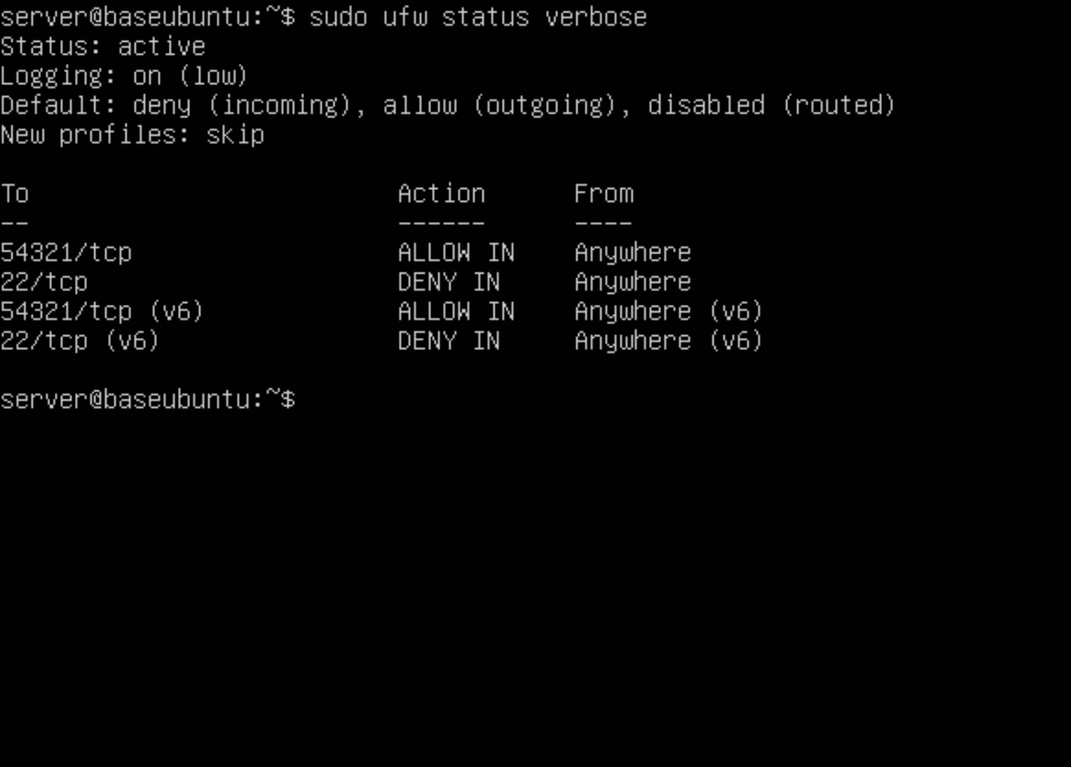
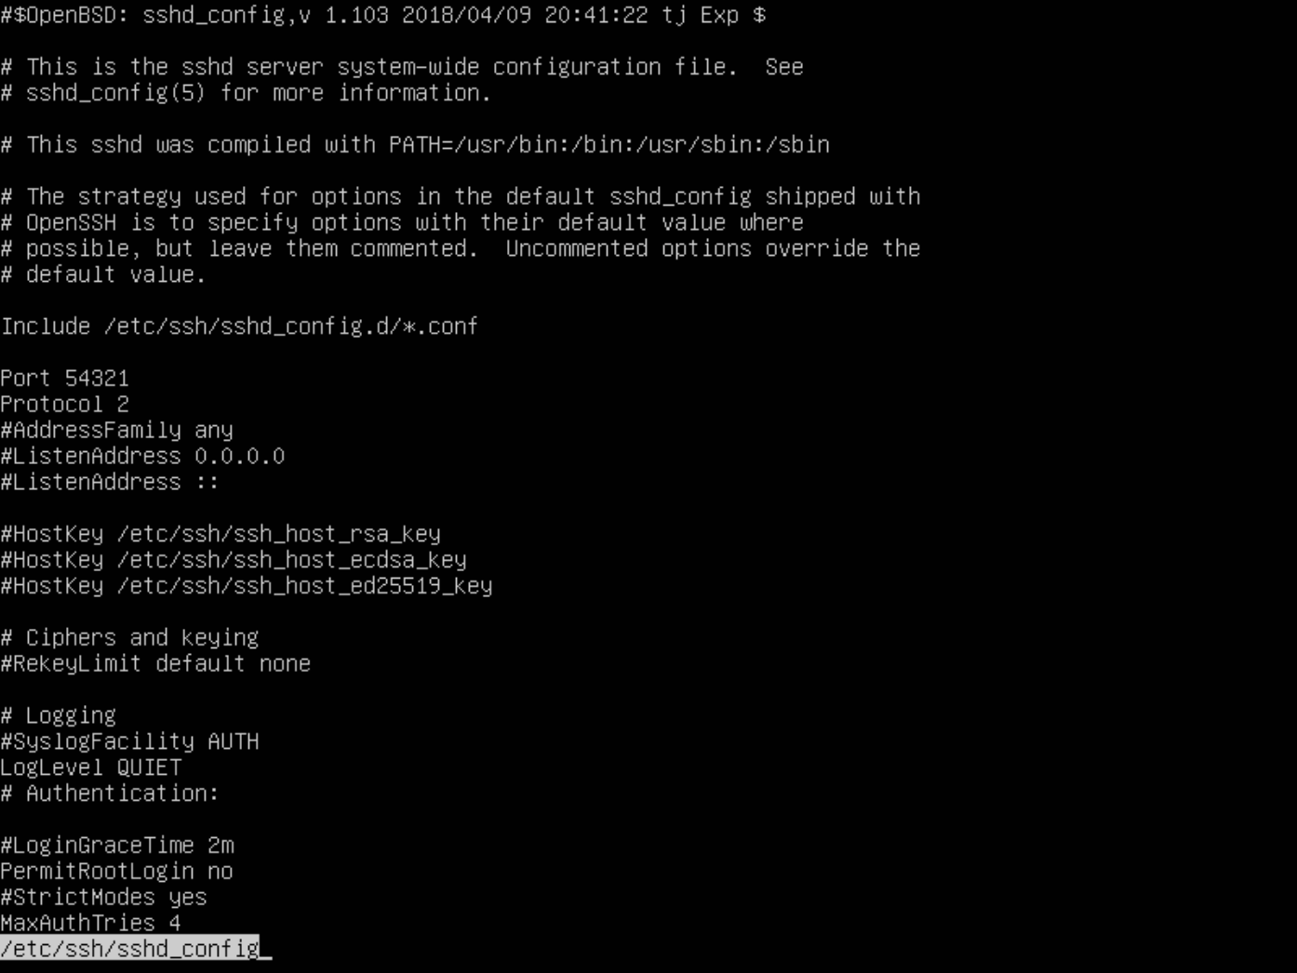
Visual Proof: UFW Status & SSH Config
UFW Status Verbose
Hardened SSH Configuration
SSH daemon configured to disallow root login and password authentication, enhancing security.
Firewall is active and correctly configured to filter SSH and allow custom port 54321.

Slide 7
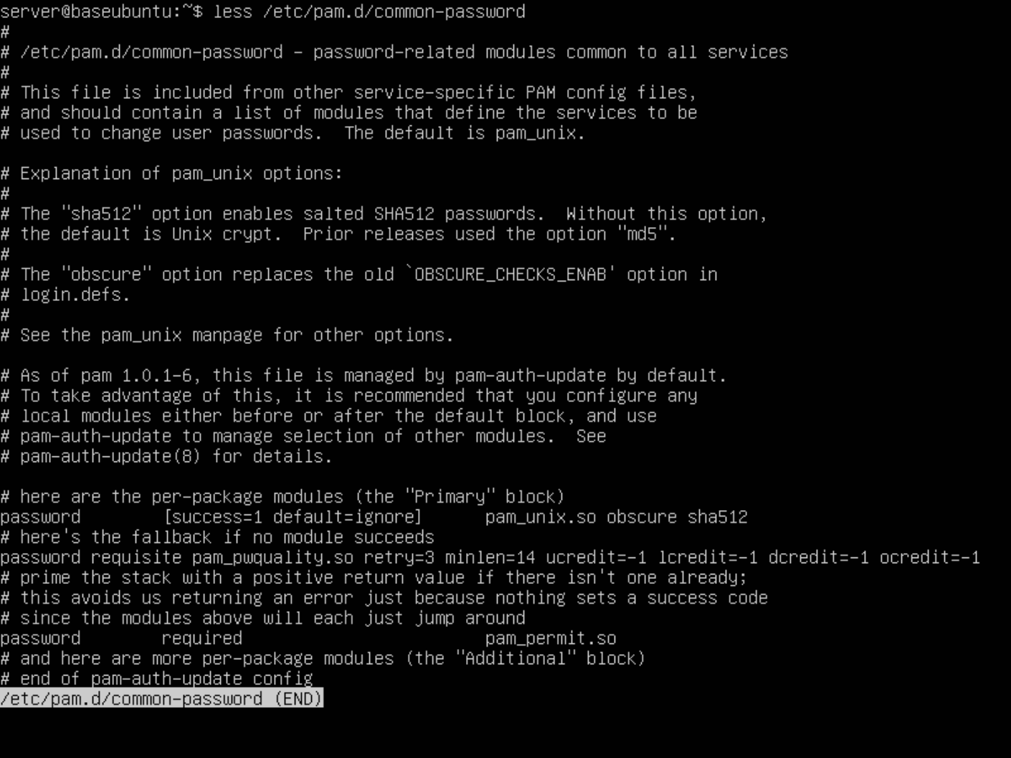
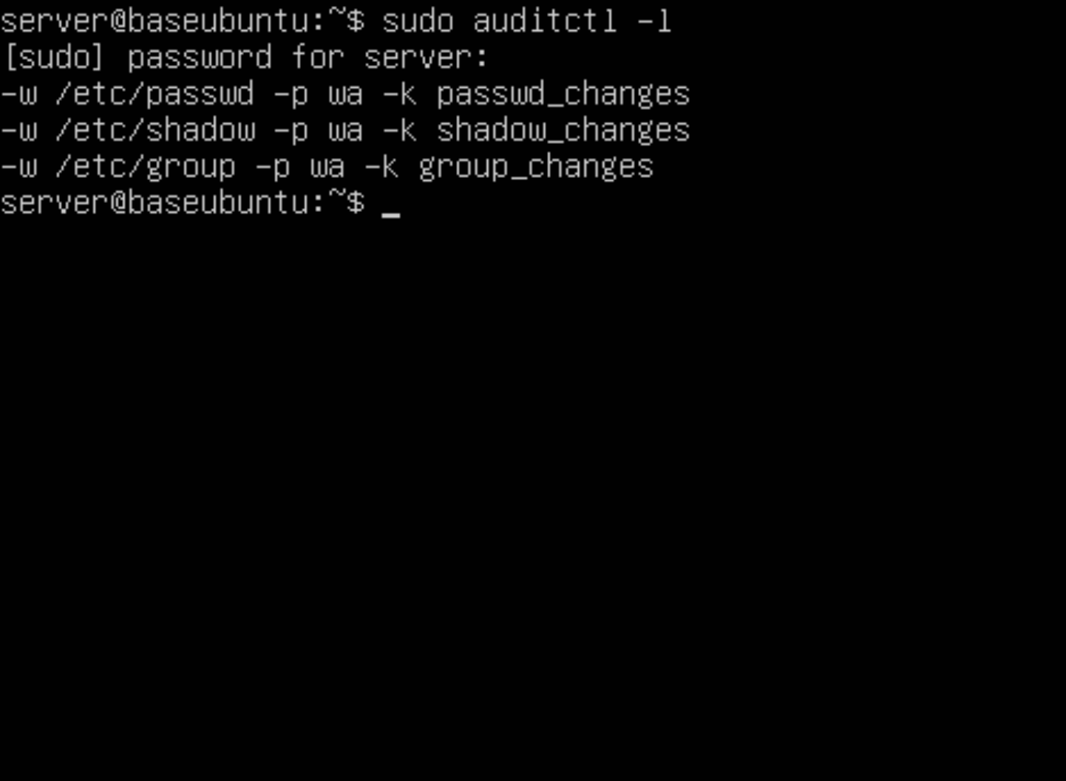
Visual Proof: PAM & Audit Logging
PAM Password Policy
Auditctl Rules
Password policy enforces strong complexity with minimum length and character variation.
Active audit rules ensure critical system events are logged for security monitoring.

Slide 8
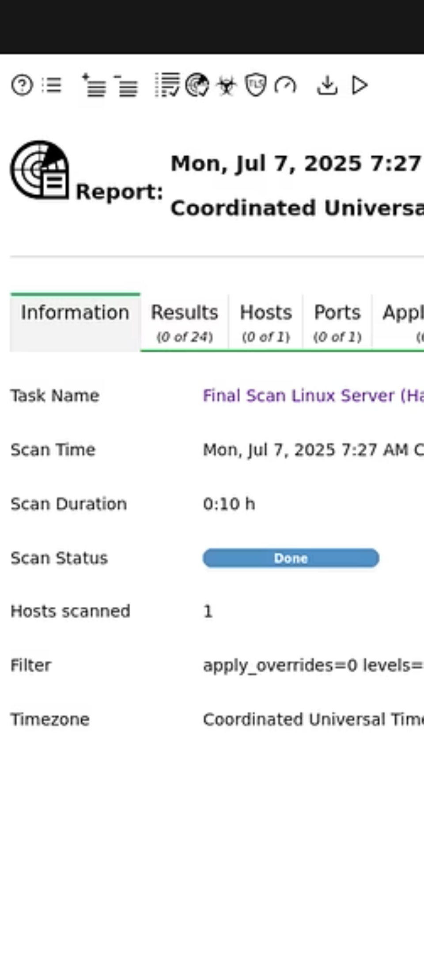

Remaining Warnings & Next Steps
GRUB Password Not Set
Recommendation: Set a GRUB password to prevent unauthorised boot option modification.
SMTP Banner Visible
Recommendation: Obscure or change the SMTP banner to avoid revealing service version.

